Slide 1
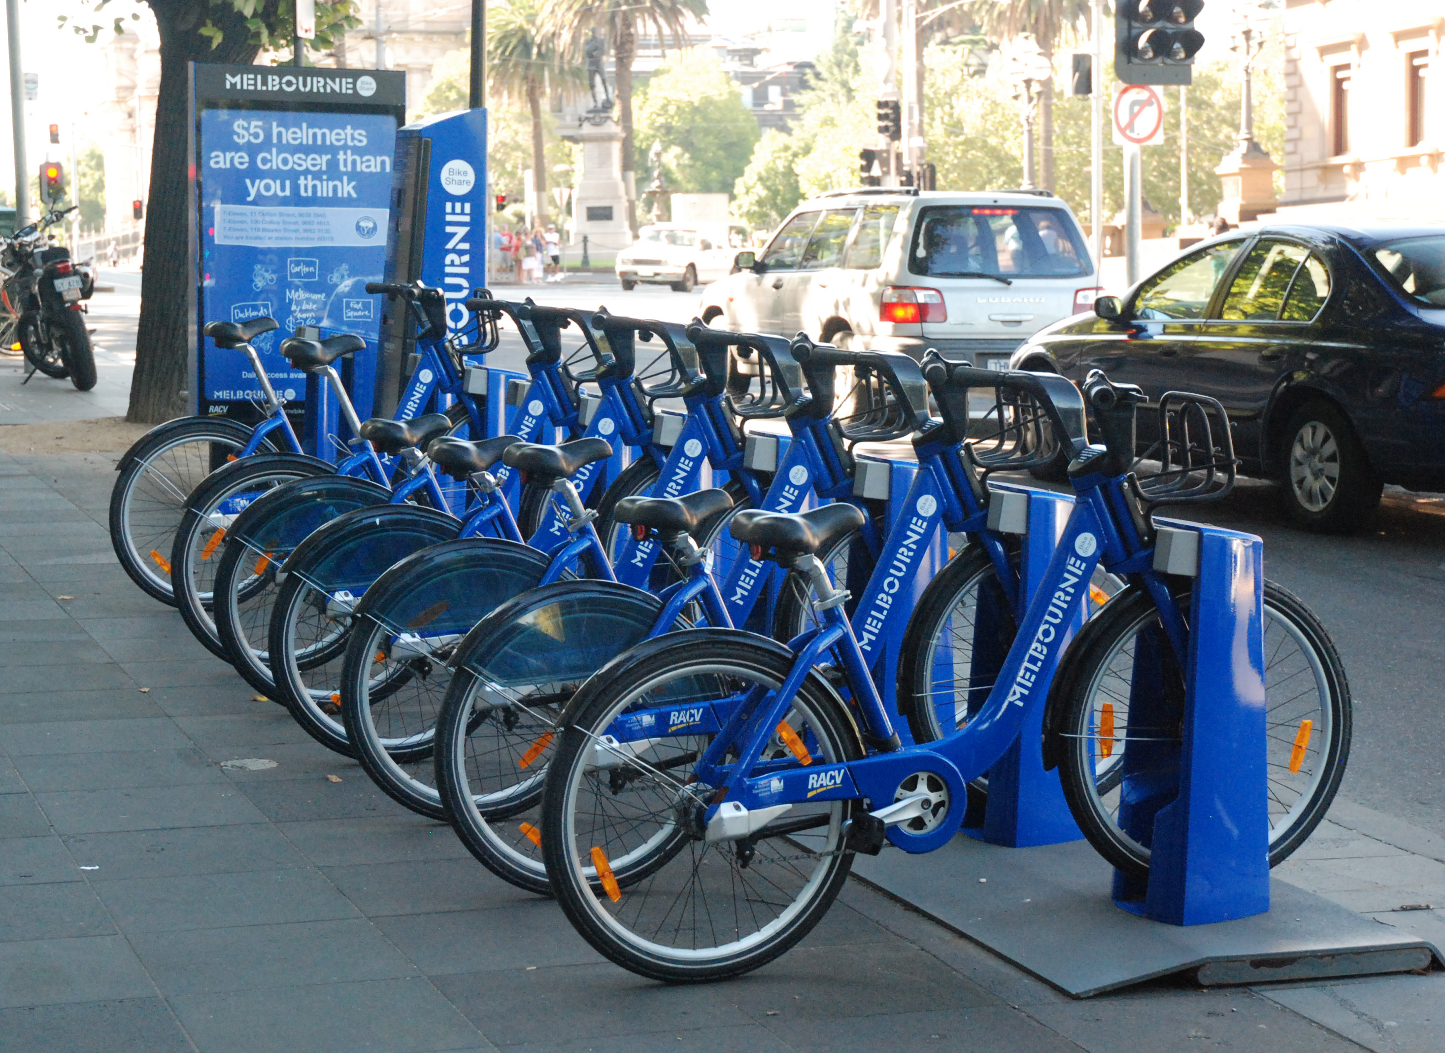
Bike Sharing System
A Healthy and convenient approach for commutation
PROJECT BY
Pragya Pramudita

Slide 2
CONTENTS
Introduction
Data Introduction
Problems and proposed solutions
Experiment and results
Conclusion

Slide 3
INTRODUCTION
Now a days ride sharing companies like Uber and lyft are great business models that provide convenient ,affordable and efficient transportation option for customers who want a hassle free ride.
With increasing number of automobiles, ride sharing in car is not efficient in crowded areas like cities downtown especially for short duration commutes.
Bike sharing is a good option which provide short range transportation option that allow them to travel without worrying about being stuck in traffic and maybe enjoy the city view or even workout at the same time.
Bike Sharing system is a service where user can rent bicycle available for shared user on term basis for price or for free and can return back after use.
Bike sharing process is highly dependent on environmental and seasonal settings
My objective of the analysis is to find out the factors that drives the demand on bike share rentals.
To explore and create a linear Regression Model so as to try to predict bike sharing demand.
My exploration and the analysis of the data will be performed in R.

Slide 4
DATA FOR ANALYSIS
Data is downloaded from UCI Bike sharing data set repository.
The initial data set had two csv files containing hourly and daily based records. Of which I have used hourly records (hours.csv)
Initial records consisted of approx.17000 observation and 17 variables for year 2011 and 2012
In my analysis I have used records for 2011 and have also removed some of the non-significant variables .
The final data consists of approx. 7000 records and 11 unique attributes.
The data set consists of a mixture of categorical and numeric data.

Slide 5
Attribute | Description | Type
season | Contains integers 1 to 4 representing "Winter", "Spring","Summer","Fall"; | multi-valued discrete
IsHoliday | Boolean expressions in 1s and 0s 0- not holiday , 1 - holiday | Binary
IsWeekday | 0 to 6 representing days from "Sun" to "Sat" | multi-valued discrete
IsWorkingday | Boolean expressions in 1s and 0s 0-not working (holiday or weekend ) , 1 -working (weekday and not holiday) -binary | Binary
month | 1 to 12 - multivalued (discrete) | multi-valued discrete
hour | 0 to 23 - multivalued (discrete) | multi-valued discrete
weathersituation | 1 to 4 - :1: Clear- 2, Mist + Cloudy,3: Light Snow - 4,Heavy Rain | multi-valued discrete
temp | air temp | continuous
humidity | humidity | continuous
windspeed | windspeed | continuous
bikeCount | total count of bike rented hourly | continuous
Here bikeCount is dependent variable on which prediction is to be made and rest are independent variable

Slide 6
PROBLEM TO BE SOLVED
My objective of the analysis is to find out the factors that drives the demand of bike share rentals
PROPOSED SOLUTION
To build and evaluate few hypothesis, build various linear regression models and assess each of these models based on different metrics like AIC & MSE, to showcase and present the best model which can help in predicting the demand of bike share rentals

Slide 7
EXPERIMENTS AND RESULTS
1.Data cleaning and pre-processing 2.Hypothesis Testing 3.Build linear regression model
4.Evaluation of models 5.Improvement in model 6.Final Evaluation of models based on MSE

Slide 8
DATA CLEANING AND PRE-PROCESSING

Slide 9
Missing values
Windspeed, had records in the form 0.00s which were randomly occurring during 0-6 hour.
Removed those records from csv file instead of replacing them with mean value .
Conversion of discrete variable to dummy variable
In the dataset , below were the discrete variables:
season : values in scale [1,4]
month : values in scale [1,12]
hour : values in scale [0,23]
Isweekday : value in scale [0,6]
weathersituation : value in scale [1,4]
I have converted month and hour to nominal variable using cut function based on median value season ,weathersituation and weekday have only few values so have directly converted them into dummy variable.
Notes:
My reason for removing these missing values instead of substituting them with other balancing values (such as mean of wind speed of the day) because I expect them to be relatively random values and replacing them with set values will cause inaccuracy in my analysis later.

Slide 10
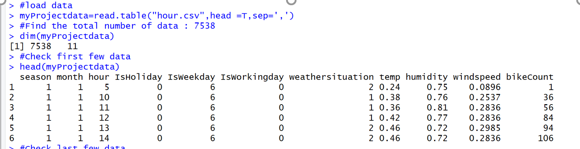
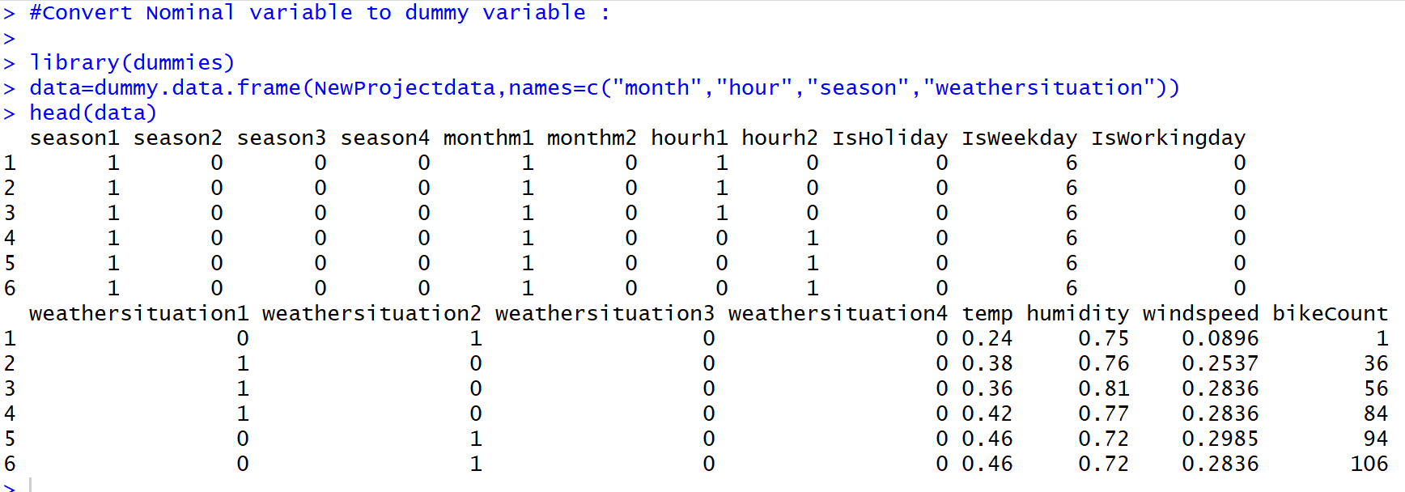
Data before pre-processing
Data after pre-processing

Slide 11
HYPOTHESIS TESTING One sample Two sample

Slide 12
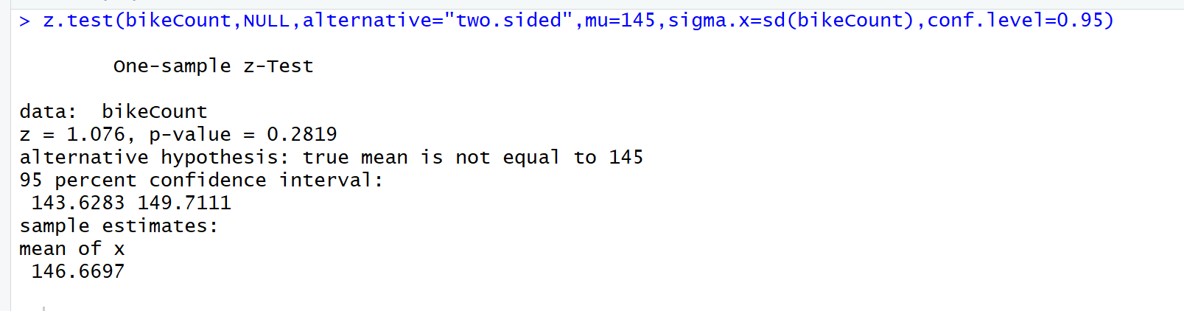
One Sample Hypothesis testing
Null Hypothesis (H0) : Average bike count rented per hour = 120
Alternative Hypothesis (Ha) : Average bike count rented per hour ≠ 120
Confidence level : 95%
From the z-test results ,p-value is greater than 0.05. Hence we can conclude that we have enough evidence to accept null hypothesis and reject alternative hypothesis. With 95% confidence level we can say that average count of bike rented per hour is 120.

Slide 13
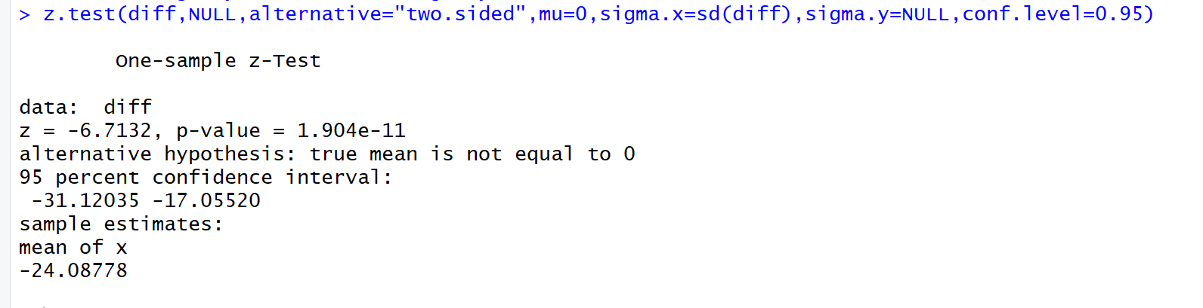
Two sample Hypothesis testing
Null Hypothesis (H0) : The total count of bike on working and non-working day will be same
Alternative Hypothesis(Ha) : The total count of bike on working and non-working days same will not be same
Confidence level : 95%
From the Z-test result p-value is less than 0.05 hence, we can conclude that we have enough evidence to reject our null hypothesis and accept alternative hypothesis.
Conclusion : Total rented bike will be different on working and non-working day based on 95% confidence level

Slide 14
LINEAR REGRESSION MODEL

Slide 15
METHODOLOGY
I have chosen Multiple Linear Regression analysis to analyse and determine the trends in the data. It is used to explain the relationship between a continuous dependent variable and two or more independent variables.
Following are the steps used in analysing the data using MLR:
Choosing between N-fold cross validation or hold out evaluation
Decision about splitting the data
Determining linearity by examining scatter plots and correlation matrix
Transformation of data (for non linear data)
Feature selection techniques
Residual analysis
Checking for multicollinearity
Selecting the best model (based on MSE)
Introducing interaction terms (dummy variables) to further improve the mode
Influential points

Slide 16
N-FOLD CROSS VALIDATION OR HOLD OUT EVALUATION?
DATA SPLITTING?
ANY WEAK CORRELATION?
IS TRANSFORMATION REQUIRED?

Slide 17
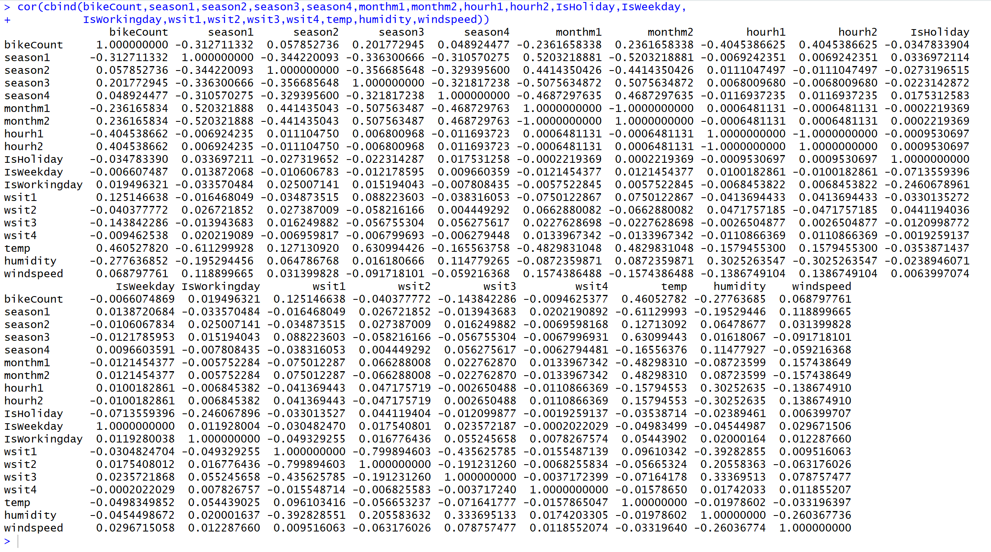


Data size was small, so decided build model based on N-fold cross validation(N=10)
No data splitting required
Correlation matrix to find linearity between the variables
Correlation between bikeCount and other continuous independent variables temp,humidity and windspeed is weak
Applied transformation on x and y variables

Slide 18
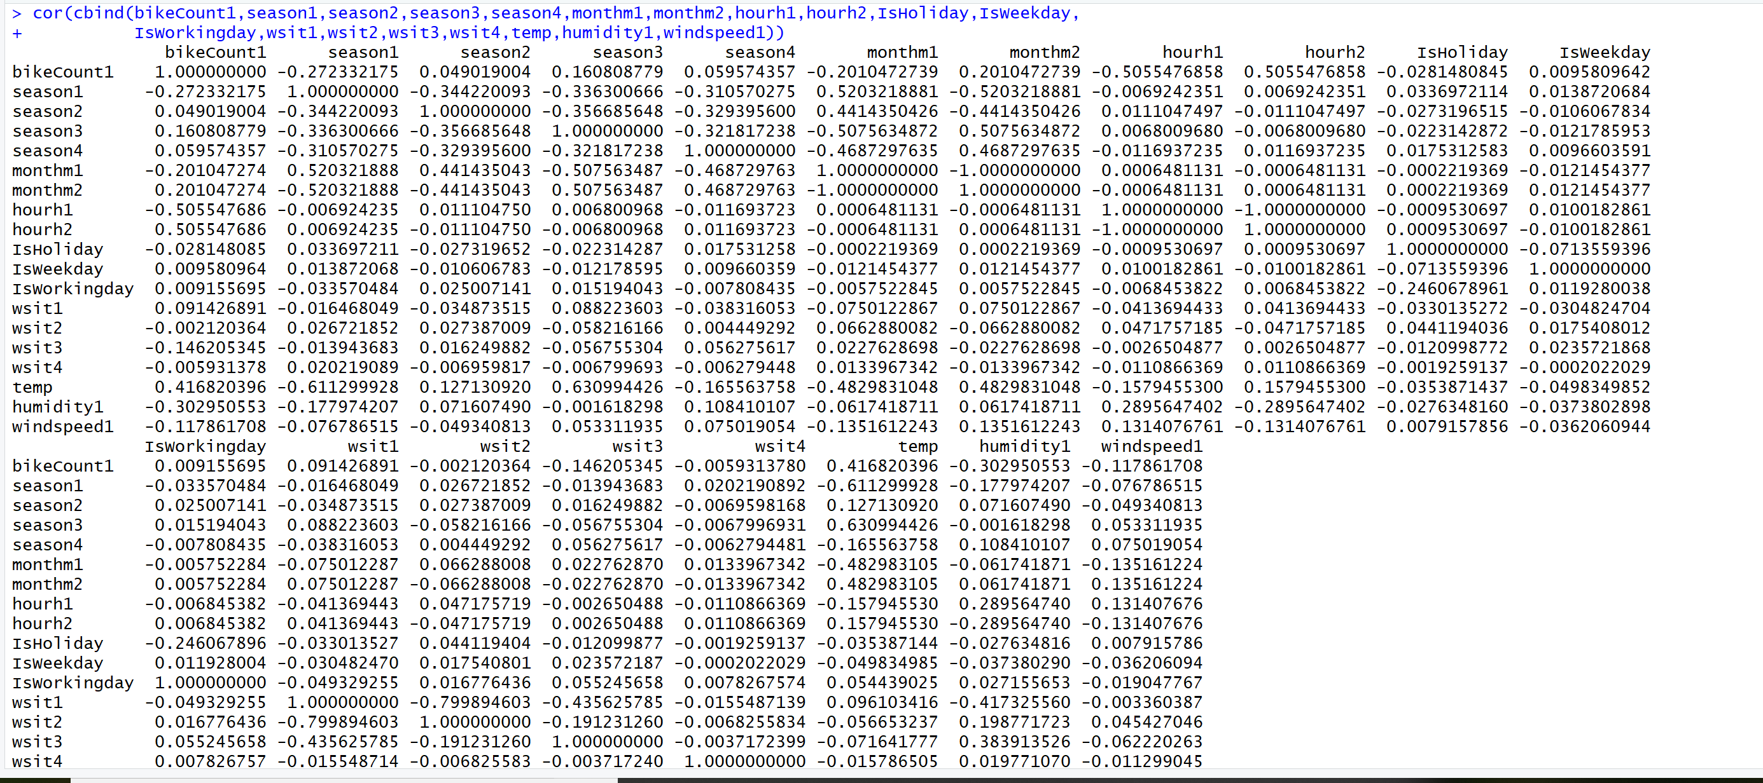

Transformation
Tried various transformation on both x and y variable. Below transformation gave the best linear relationship
Log transformation on y-variable bikeCount :
bikeCount1 = log(bikeCount)
Square transformation on humidity :
humidity1 = humidity* humidity
Inverse Transformation on windspeed:
windspeed1 = 1/windspeed
Correlation is improved after transformation

Slide 19
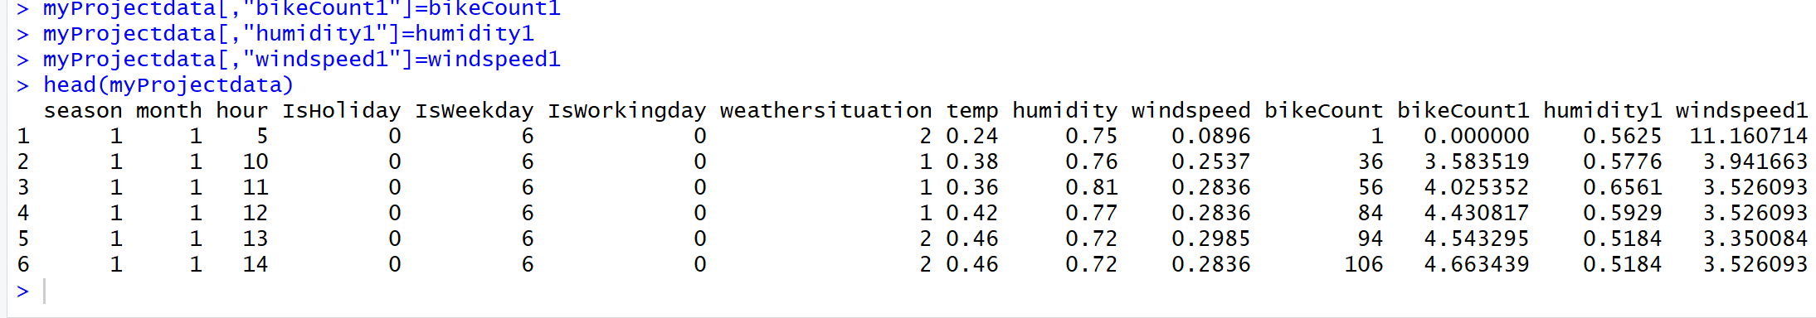
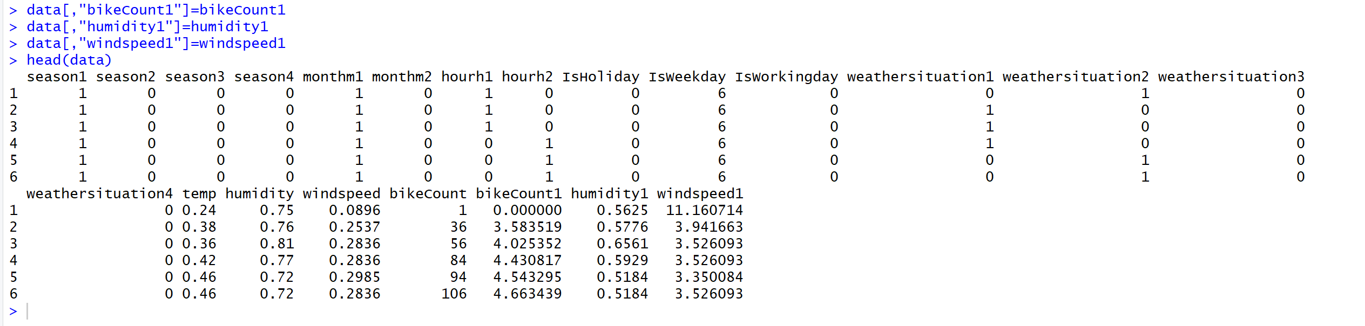
FINAL DATA SET TO BUILD MODELS
Data set before pre-processing
Used both the data set in building models
Pre-processed data

Slide 20
APPROACHES FOR BUILDING MODELS

Slide 21
Models built using feature selection technique
Model excluding all the dummy variable and applied stepwise regression (backward, forward and full) to build other models. Decided the best model based on AIC
Model including all the independent variable but without pre-processing
Model including all the independent variable and pre-processing the data using as.factor directly in the model
Model considering all the dummy variable from pre-processed data set
After building the model, applied stepwise regression in all the 4 models and selected the best one from each set based on AIC value for further improvement

Slide 22
Model | Model description | Model | AIC | MSE
1 | full:Full model without considering discrete variable. | full=glm(formula = bikeCount1 ~ temp + humidity + humidity1 + windspeed1, data = myProjectdata) | 24581 | 1.52586
2 | full1:Full model considering discrete variable but without pre-processing | full1=glm(formula = bikeCount1 ~ temp + humidity + humidity1 + windspeed1 + season + month + hour + IsWeekday + IsWorkingday + weathersituation + IsHoliday, data = myProjectdata) | 21843 | 1.061978
3 | full2:Full model considering discrete variable and pre-processing using as.factor directly when building the model | full2=glm(formula = bikeCount1 ~ as.factor(season) + as.factor(month) + as.factor(hour)+as.factor(IsHoliday) + as.factor(IsWeekday) + temp + humidity + humidity1 + windspeed1, data = myProjectdata) | 14298 | 0.412321
4 | full3:full model considering all the dummy variables | glm(formula = bikeCount1 ~ temp + humidity + humidity1 + windspeed1 + as.factor(IsWeekday) + as.factor(season1) + as.factor(season2) + as.factor(season3) + as.factor(monthm1) + as.factor(hourh1) + as.factor(IsHoliday), data = data) | 22632 | 1.178398
Model 3 is the best among the 4 models with least MSE ,selected this model for further improvements

Slide 23
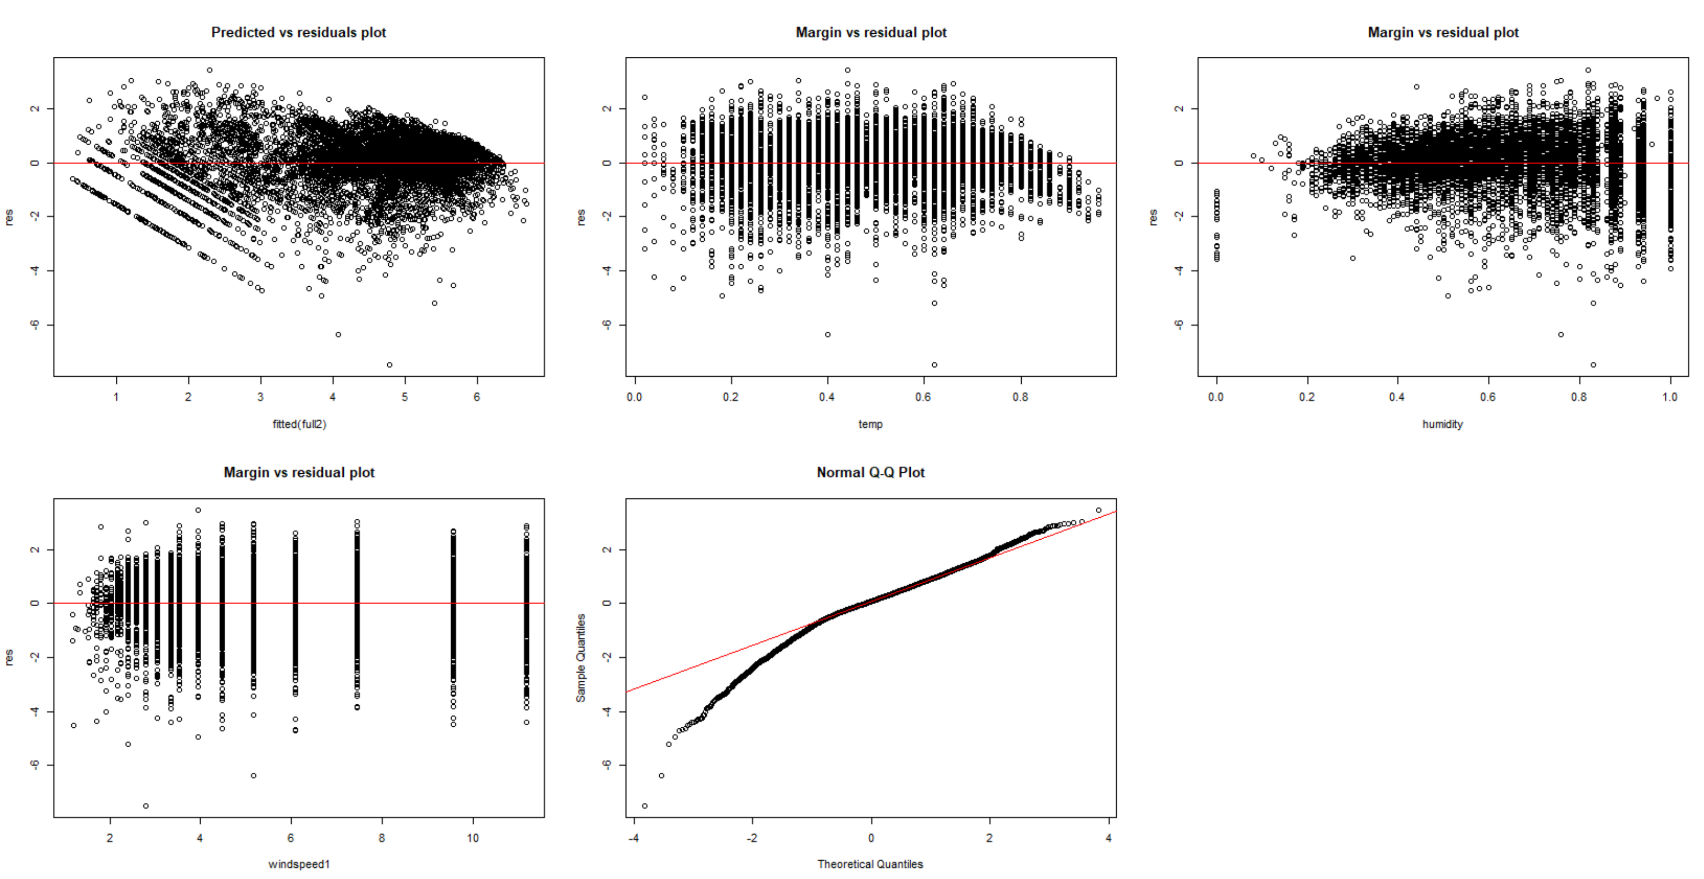
Residual Analysis
Results of residual analysis performed on model 3

Slide 24
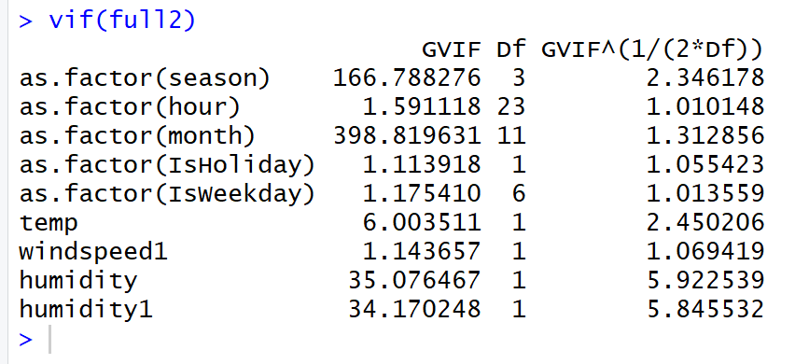
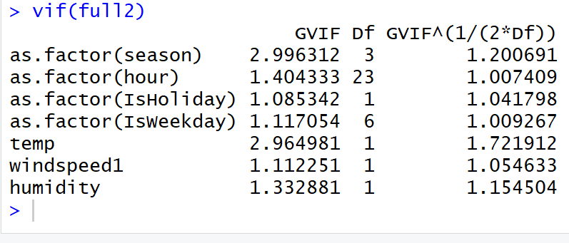
Multicollinearity using VIF
Results of multicollinearity using VIF on model 3

Slide 25
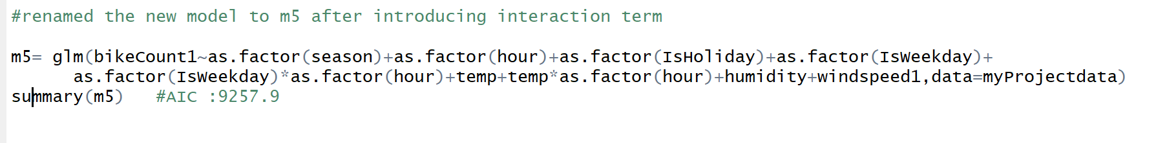
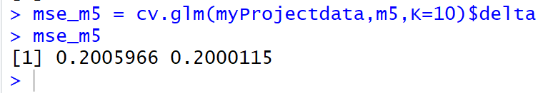
Interaction Terms
Introduced interaction term to the model 3 to further improve the model
Included hour as an interaction term with numerical variable temp and dummy variable IsWeekday
Model has improved significantly after introducing interaction term in terms on MSE and AIC
MSE of model 3 improved after adding interaction term

Slide 26
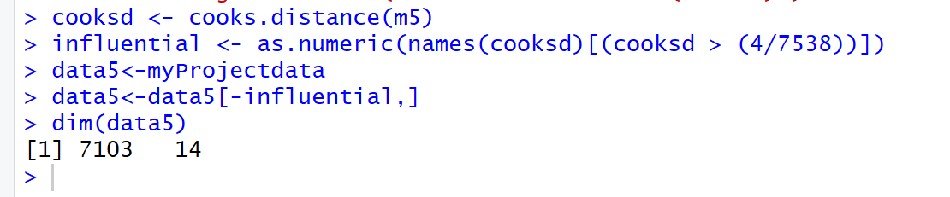
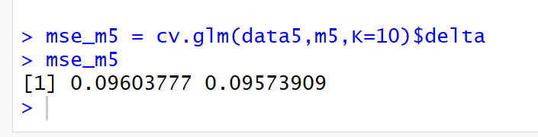
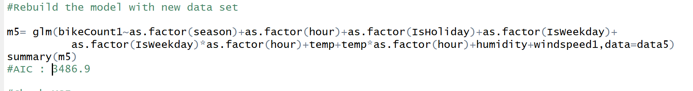
Influential points

Slide 27
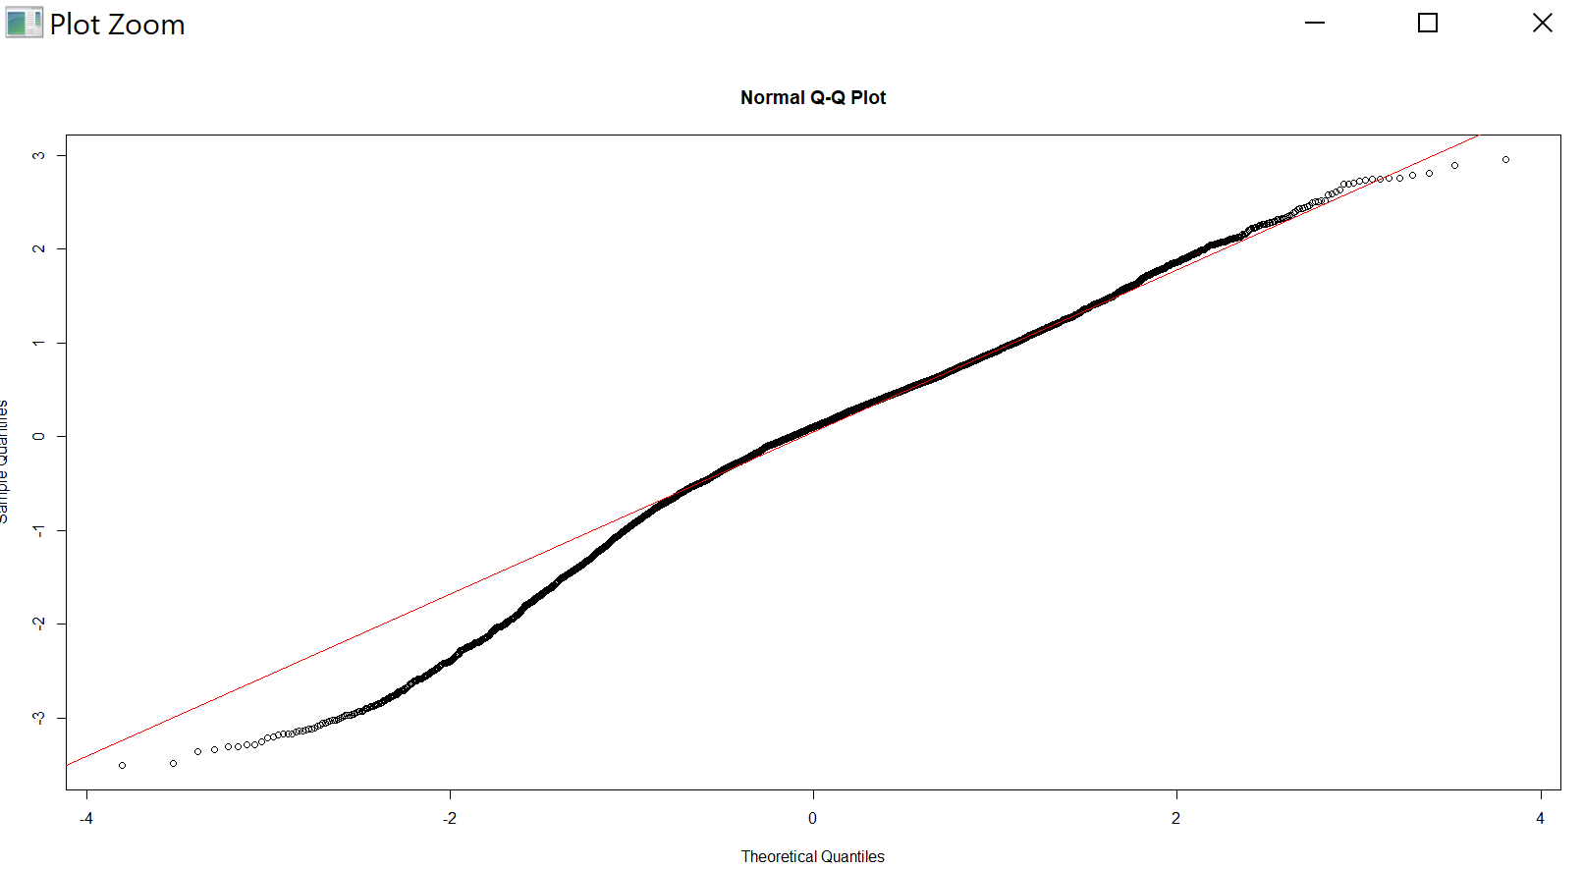
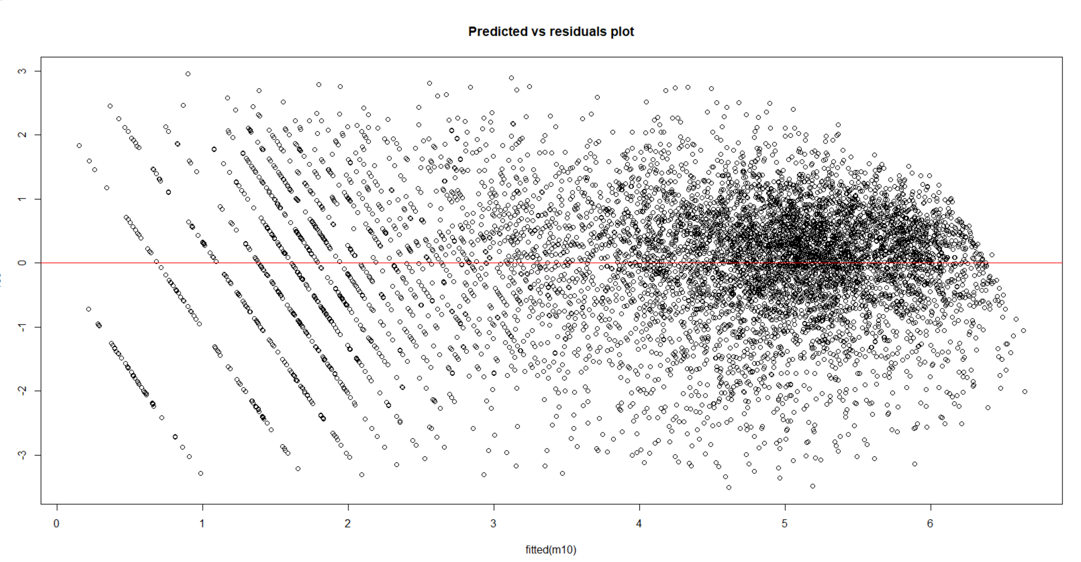
Residual Analysis
Results of residual analysis performed on final model(m5)

Slide 28
Challenges & RESULTS
CHALLENGES FACED:
Determining the predicted values for the best label for different seasonal and environmental settings
Determining which transformation will provide best fit for the given models.
Determining the impact of outliners and other influential factors.
Addressing multicollinearity problems among different independent variables.
RESULTS:
Different transformation techniques and residual analysis can be applied to determine the best fit model.
By using different techniques like cooks distance matrix or hat values we can determine outliers/ influential points.
Multicollinearity problems can be handled by using different techniques (Pearson Correlation matrix, scatter plots or VIF statistics).

Slide 29
CONCLUSION
Based on the different models, the experiments performed and evaluations done on them using various techniques and metrics, the best model we have for the bike share systems is one which has the season, hour, temp, windspeed, humidity ,IsWeekday and IsHoliday variables.
Also from the experiments I found the below relationships among the data, that would help in understanding the demand of bike shares
Count of bike rental is highly influenced by temperature as it has high correlation coefficient .The count of bike rental will increase if temp increases .
Humidity also influences the count of bike rental .
Windspeed won’t have much effect on count of bike rental as its coefficient is very low.
In winter there will be more rental as compared to summer and fall.
During hour 8 to hour 21 of any 24hr day, count of bike rental will be more as compared to other hours
Weekends will have more rentals as compared to weekdays
All the independent variables are significant to make the prediction as p-value is less than 0.05

Slide 30
Thank You

